Slide 1
Rotary International GG2119501 Upper East Region of Ghana Transforming Communities Improving Lives
East Lansing Rotary Club
Tamale Ghana Rotary Club
June 2024 (slide deck Beta version 1.0)

Slide 2
East Lansing Rotary Club International Service Committee Members
Rick Simonds
Sung Lee
Ger Schultink
Mark Henne
Jim Little
Jim McCoy
Joe Osypczuk
Jeff Fineis

Slide 3
Project Purpose
Help alleviate poor nutritional conditions for children in Upper East Region of Ghana and build community pride among women

Slide 4
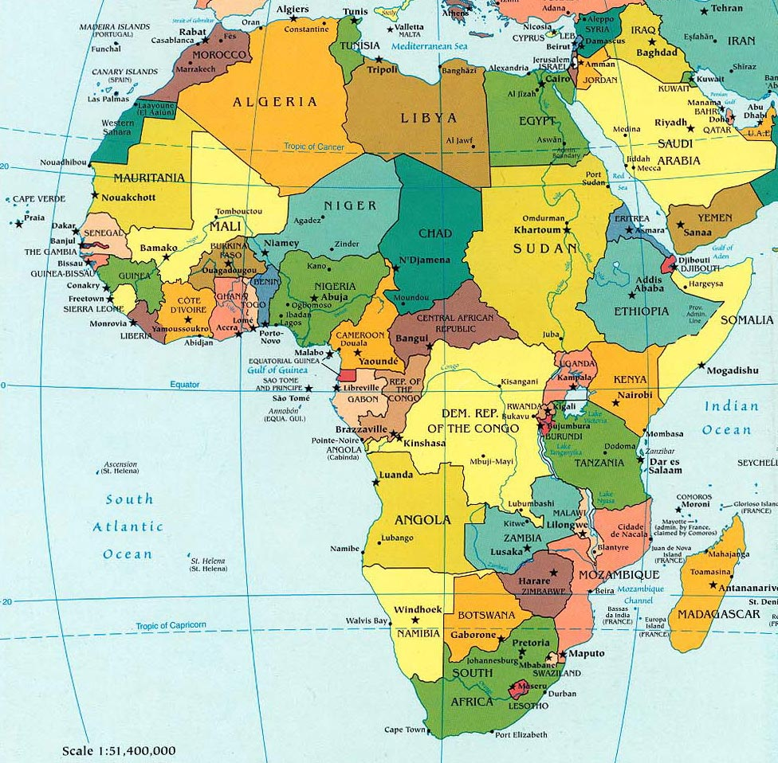
This Photo by Unknown Author is licensed under CC BY-NC-ND

Slide 5
Ghana
This Photo by Unknown Author is licensed under CC BY-SA

Slide 6
Dedication Ceremony Attendees

Slide 7
Other Information Information on Dr. Clement K. Kubuga Primary on the ground Project Leader Dr. Clement K. Kubuga University for Development Studies, Tamale Earned Ph.D. from Michigan State University in2018 Studied under Professor Won O. Song College Agriculture and Natural Resources Department Food Science and Human Resources

Slide 8
General Information
Two Bore holes each drilled to 95 meters
Two community garden sites, Sakaa and Nakolo, 1 acre each
Plastic membrane is used30-50 cm below soil surface
Number of women participating in community gardening at each site is115 at Sakaa and 74 at Nakolo
Cost of two sites $50,000, $15,000 RI Global Grant, $15,000 District Grant 6360, $20,000 from East Lansing Rotary Members, Club Foundation, other Clubs and non-Rotary individuuals
Two sites are in Upper East Region Ghana,
Total project time 3years (funding to harvesting)

Slide 9
Crop Production presently consists of
The dry season gardening is solely for vegetables
Hibiscus sabdariffa leaves
Cabbage
Amaranth
Okro
Bean leaves
lettuce

Slide 10
Colleagues in Tamela Rotary Club
Mary Arabe
Emmanuel Nana-Asare
Sem Komain Buamey

Slide 11
Community Members in field site

Slide 12
Close up of tank.

Slide 13
Clearer view of expanse of site

Slide 14
Second view
Photo taken on Dedication date

Slide 15
View of crops

Slide 16
Irrigation pumps

Slide 17
Irrigation system

Slide 18
Look at solar panels

Slide 19
Borehead pump

Slide 21
Women arriving at dedication site

Slide 22
Media coverage

Slide 23
Mary conferring with Clement Kubuga and Emmanuel Nana-Asare

Slide 24
Women from second community site arriving

Slide 25
Recognition Signage

Slide 26
Festivities about to .begin

Slide 27
Tamale Rotary colleagues
Emmanuel Nana-Asure
Sem Koman-Kuma
Mary Arabe

Slide 28
Crowd seated

Slide 29
Dancing begins

Slide 30
More dancing

Slide 31
Mary joining in.

Slide 32
Speech time
Pro. Slyvester N, Ayambila
WACWISA
University for Develment Studies
,Tamale, Ghana
.

Slide 33
VIP
Mr. Emmanuel Nana-Asare, Rotary District 9104
Ms. Mary Arabe,Rotary District 9104
Dr,
. Clement K. Kubuga, WACWISA University for Development Studies, Tamale Ghana
Mr. Sem Komian Buamey, Rotary District 9104
Professor Sylvester N. Ayambila WACWISA-University for Develment Studies, Tamale Ghana

Slide 34
Goat Presence

Slide 35
Now a chicken has been included

Slide 36
More speeches

Slide 37
Project complications (1) uncertain inflation rates (2)volatility in exchange rates 3)short weather window suitable for bore hole drilling (4) fragility of irrigation system

Slide 38
What comes next ?
Further evaluate plot production vis a vis expectations
Implement community improvement recommendations
Implement Kubuga recommendations
Evaluate possible expansions to other communities*
*Per Clement Kubuga 10 communities have repeatedly asked for similar projects to Rotary sites
Conduct financial analysis of sustained viability
Assess local NGO private funding possibilities
Measure improvements in children’s health with this new food source

Slide 39
2021 Ghana Project Donors
Won O Song Trust Bill Brewer
John Saltzgaber Joanne & Ger Schultink
Eunil Lee Grace Lee
Jim Little Richard Simonds
Joe Osypczuk James McCoy
Bob Page Bonnie Pollack
Maribeth Fletcher Steven Lee
Nanda Joshi Rotary Club Berrien Springs/Eau Claire

Slide 40
Donors Continued
William McMillan Marian Prince
Mark Henne Tim Mcaffrey
Sharon Hoerr Twesigye Kaguri
Rotary Club of Battle Creek Victor Farmington Rotary Club
Rotary Club of East Lansing Karen Parkhurst Farmington R.C.
John (Irv) Nichols
Jim & Georgiana Gormley
Darlene Heemstra

